Slide 1

Lecture 1: Introduction

Slide 2
Outline
Why should you take this class? And why not?
Who are we?
Course structure and activities: What can you expect?
Class organization: What are the workload, logistics, and grading system?
Projects

Slide 3
Outline
Why should you take this class? And why not?
Who are we?
Course structure and activities: What can you expect?
Class organization: What are the workload, logistics, and grading system?
Projects

Slide 4
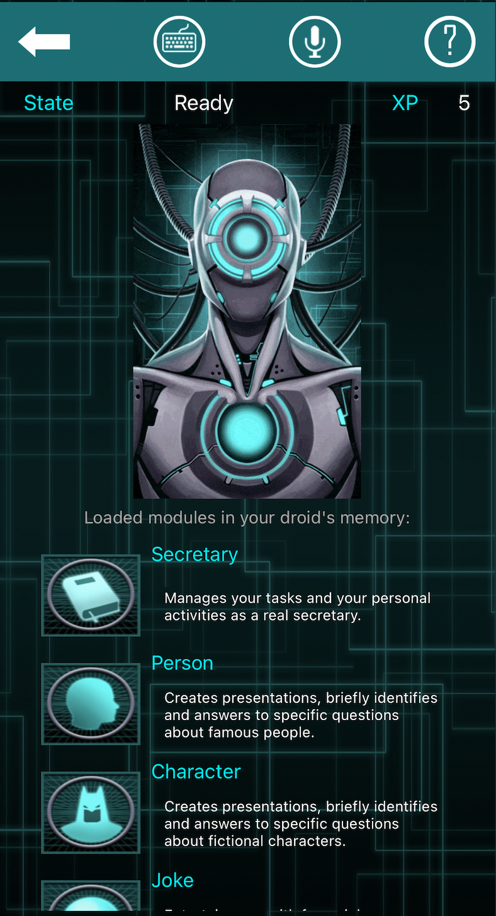
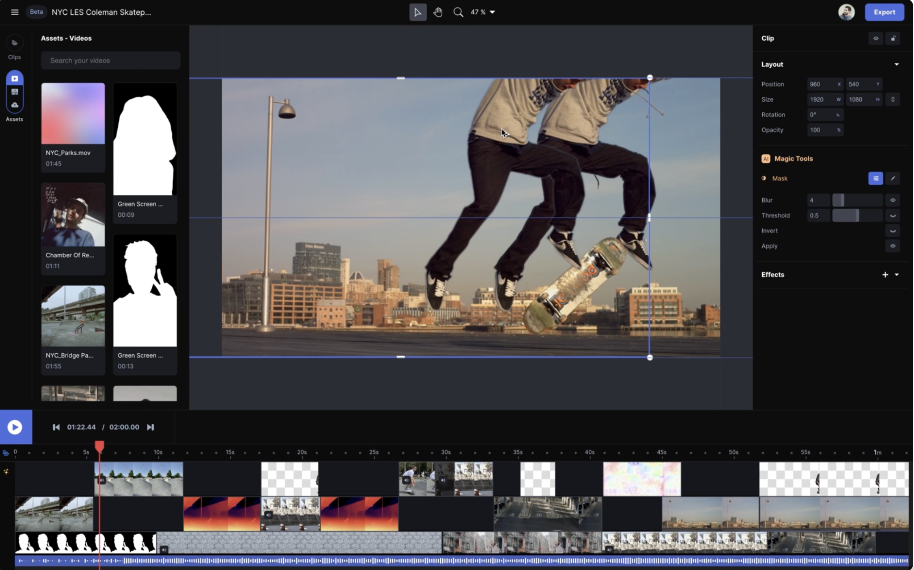
Why You Should Take This Class
So you can build awesome apps like this:
https://runwayml.com/
https://www.databot-app.com/
Notes:
runwayml: Magical AI tools, realtime collaboration, precision editing, and more. Your next-generation video creation suite.
DataBot: is the protocol droid designed
to serve you. It answers with its voice to your requests
upon topic you are interested in.

Slide 5
Why You Should Take This Class
Because you want to:
Put your models into production
Build an application using your models
Take advantage of available models
Integrate and orchestrate applications
Deploy and manage increasing amounts of data

Slide 6

Why You Should Take This Class
What students said in previous iterations
“This course helped me with kickstart a startup”
“This course helped me land a job - nailed that interview”
“The ‘money’ course. Truly one of the most practical course”
“I knew some of these concepts but going through all gave me a good idea why and what”
“It was fun! I love Pavlos”

Slide 7
Reasons This Course May Not Be For You
1. Lack of Commitment: This course demands full engagement with both materials and projects.
2. Expectation of a Traditional Lecture Format: This is a project-based course, focused on hands-on learning.
3. Limited Background in Prerequisites: If you are unfamiliar with key concepts from CS109A/B such as:
Basic Machine Learning
CNNs, RNNs, Autoencoders, Language Models, GANs, etc.
Basic shell commands.

Slide 8
Reasons This Course May Not Be For You
4. Unwillingness to Receive and Apply Feedback: We provide detailed feedback on your projects and expect you to implement changes in subsequent milestones.
5. Seeking a "Easy A": While project-based courses may seem easier, we hold rigorous evaluation standards.
6. Thinking this is CS109C: This course is not about learning new models and methods. Instead, it focuses on productionizing your existing knowledge and skills.
7. You do not like cheese!

Slide 9
Reasons This Course May Not Be For You
What students said in previous iterations
“This is more of an engineering course than a traditional data science or ML course.”
• “You won’t learn many new methods here.”
• “Why work on GCP instead of AWS, which is the leading cloud computing platform?”

Slide 10

Reasons This Course May Not Be For You
• “No homework! Because this is a team-based course, you might miss out on learning some key concepts.”

Slide 11
Motivation
Mckinsey Global Survey findings on Adoption of AI shows nearly 25% year over year increase in the use of AI. 50% of companies spend between 8 and 90 days deploying a single AI model, with 18% taking longer than 90 days. A report by IDC that surveyed 2,473 organizations and their experience with ML found that a significant portion of attempted deployments fail, quoting lack of expertise, as one of the key factors.^{[1]}
[1] https://arxiv.org/pdf/2011.09926.pdf
Notes:
International Data Corporation (IDC)
https://venturebeat.com/ai/idc-for-1-in-4-companies-half-of-all-ai-projects-fail/: Despite enterprises’ best efforts, painless AI deployments appear destined to remain elusive for all but the most dogged adopters. A recent study conducted by analysts at International Data Corporation (IDC) found that of the organizations already using AI, only 25% have developed an “enterprise-wide” AI strategy, and it found that among those in the process of deploying AI, a substantial number of projects are doomed to fail.
IDC’s Artificial Intelligence Global Adoption Trends & Strategies report, which was published today, summarizes the results of a May 2019 survey of 2,473 organizations that use AI solutions in their operations. It chiefly focused on respondents’ AI strategy, culture, and implementation challenges, as well as their AI data readiness initiatives and the production deployment trends expected to experience growth in the next two years.

Slide 12
Motivation
A recent International Data Corporation (IDC) survey of global organizations that are already using artificial intelligence (AI) solutions found only 25% have developed an enterprise-wide AI strategy. At the same time, half the organizations surveyed see AI as a priority and two thirds are emphasizing an "AI First" culture.
IDC: https://www.idc.com/

Slide 13
Enrollment: Cap, Pending Status and Criteria
Some of you have petitioned for the course but have not yet been approved. Why?
I typically avoid capping courses unless it impacts the quality and experience.
Currently, the class is capped at 110, with 25 students pending.

Slide 14
Enrollment: Cap, Pending Status and Criteria (cont)
Challenges:
• It’s difficult to find teaching staff due to the specialized material covered.
• I want to monitor the progress of projects and interact with all students.
• We can’t provide cloud credits for everyone.
Considerations for Enrollment:
• Likelihood of the student taking the course next year.
• Whether the course is a program requirement.
• Comments in my.harvard.
I anticipate some students will drop the course, which will open up additional spots.

Slide 15








Data Science Series to Real World
Data Science Series CS109 A/B
Data
Models
Results
Collection
Exploration
Preparation
Exploration
Experimentation
Training
Evaluation
Blogs
Reports
Presentations
BI Dashboards
Single developer on one computer. Projects are individual to 2-3 member team.

Slide 16






Data Science Series to Real World
Real World
Data
Models
Apps
Distributed
Collection
Exploration
Preparation
Recombine
Distributed
Exploration
Experimentation
Training
Evaluation
Pre-trained models
Compare / Ensembles
Siri / Alexa
FaceApp
Socratic
Team of developers on single/ multi node clusters on a Cloud Platform. Projects are 5+ member teams
Notes:
Socratic is an AI App to make learning easier. It helps students with their homework by providing educational resources like videos, definitions, Q&A, links and more.

Slide 17
Data Science Series to Real World (cont)
Challenges:
Onboarding Procedures for New Team Members:
Required Installations for Specific Operating Systems:
All team members have the necessary software and tools installed on their systems.
Guidelines for Code Collaboration:
Version control and code reviews.
Methods for Sharing Datasets and Models
Automation of Data Gathering and Model Training
Resolving “It Works on My Machine” Issues

Slide 18
Ops for Machine / Deep Learning
Development Operations (DevOps):
Unifies software development (Dev) & operations (Ops) for efficiency.
AI Operations (AI Ops):
Integrates ML/DL model development with app development & operations.
Notes:
DevOps is a practice that brings together software development (Dev) and operations (Ops) to streamline the process for better productivity and shorten development life cycle.
MLOps is a practice that brings together machine learning or deep learning model development, application development, and operations together to streamline the interaction between the three and simplify the machine learning life cycle.

Slide 19
AI Ops - Tasks
Machine / Deep Learning:
Data collection & exploration
Model exploration & selection
Training & evaluation
Distillation & compression
Application Development:
APIs / Model serving
ML integration
Web & mobile apps
Edge device apps
Automation scripts
Operations:
Provisioning and managing deployment servers, on-demand GPU servers
Maintain 100% uptime of app / apis
CI/CD: Continuous Integration / Deployment
Continuous Data Collection / Model Training
Model/data monitoring
Model/data versioning
ML Workflow Management
Notes:
Edge device: are equipment that serve to transmit data between the local network and the cloud. They are able to translate between the protocols, or languages, used by local devices into the protocols used by the cloud where the data will be further processed and stored. Smart home devices are good examples of edge computing devices. Alexa echo, Nest Cam / Doorbell etc.

Slide 20


MLOps - Tech Stack
Data
Models
Development
Operations
Data Engineers
Data Scientists
Software Engineers
Systems Engineers
Notes:
Data Engineers: A data engineer is a technology professional who builds storage solutions for vast amounts of data. These engineers are also responsible for creating the pipeline the data travels through: from input, to storage, to transformation into usable information
Data Scientists:
Software Engineers:
Systems Engineers:

Slide 21






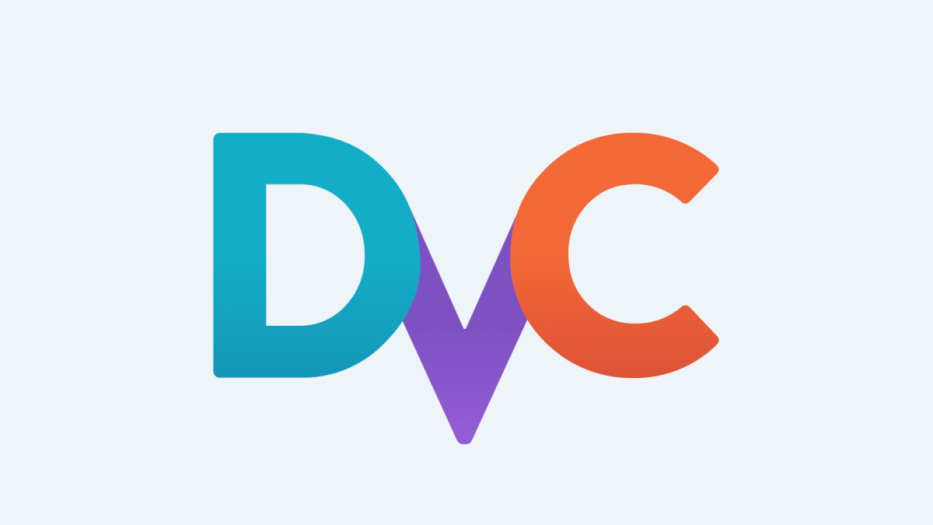

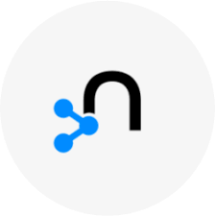

MLOps - Tech Stack
Data
Models
Development
Operations
Spark
Hadoop
Kafka
Bigquery
Airflow
Vertex AI Pipelines
DVC
Elastic
Neo4j
Weaviate
Data Engineers
Data Scientists
Software Engineers
Systems Engineers
Notes:
Apache Spark: is a unified analytics engine for big data processing, with built-in modules for streaming, SQL, machine learning and graph processing.
Hadoop: is a framework that allows for the distributed processing of large data sets across clusters of computers using simple programming models
Kafka: is a distributed event streaming platform for high-performance data pipelines, streaming analytics, data integration, and mission-critical applications
Bigquery: BigQuery is Google's fully managed, serverless data warehouse / data lake that enables super-fast SQL queries using a distributed infrastructure similar to Hadoop and Spark
Airflow: is a platform started by AirBnB to programmatically author, schedule, and monitor workflows.
Vertex AI Pipelines: Vertex AI Pipelines lets you automate, monitor, and govern your machine learning (ML) systems in a serverless manner by using ML pipelines to orchestrate
DVC: Open-source version control system for Data Science and Machine Learning projects. Git-like experience to organize your data, models, and experiments.
Elastic: Elasticsearch is the world’s leading free and open search and analytics solution. With an emphasis on speed, scale, and relevance it's transforming how the world uses data.
Neo4j: is a graph database that combines native graph storage, advanced security, scalable speed-optimized architecture, and ACID
Weaviate: Weaviate is an open source vector search engine that stores both objects and vectors, allowing for combining vector search with structured filtering with the fault-tolerance and scalability of a cloud-native database, all accessible through GraphQL, REST, and various language clients.

Slide 22










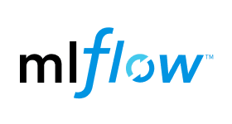



MLOps - Tech Stack
Data
Models
Development
Operations
Spark
TensorFlow
PyTorch
MXNet
Hadoop
Kafka
JupyterLab
Google Colab
Bigquery
Deepnote
Vertex AI Models
Airflow
Amazon Sagemaker
Vertex AI Pipelines
OpenAI
Gemini
Anthropic
DVC
Elastic
Weights & Biases
Neo4j
Weaviate
Kubeflow
Neptune.ai
Data Engineers
Data Scientists
Software Engineers
Systems Engineers
Notes:
TensorFlow: Open source Deep Learning library built by Google
PyTorch: Open source Deep Learning library built by Facebook
MXNet: Open source Deep Learning library built by Apache
JupyterLab: web-based user interface that enables you to work with documents and activities such as Jupyter notebooks, text editors, terminals, and custom components in a flexible, integrated, and extensible manner.
Google Colab: Colab is a Jupyter notebook environment provided by Google that runs entirely in the cloud
Deepnote: is a data science notebook. Jupyter-compatible with real-time collaboration and running in the cloud.
Google AI Platform (Vertex AI): A unified UI for the entire ML workflow. Vertex AI brings together the Google Cloud services for building ML under one, unified UI and API.
Amazon Sagemaker: is a fully managed service that provides every developer and data scientist with the ability to build, train, and deploy machine learning models.
MLFlow: is a platform to streamline machine learning development, including tracking experiments, packaging code into reproducible runs, and sharing and deploying models.
Weights & biases: helps deep learning research projects into deployed software by helping teams track their models, visualize model performance and easily automate training and improving models.
Kubeflow: helps deployments of machine learning (ML) workflows on Kubernetes simple, portable and scalable.
Neptune.ai: is a metadata store for MLOps, built for research and production teams that run a lot of experiments.
H2O.ai: is an end-to-end platform that enables organizations to rapidly build world-class artificial intelligence models and applications.
Determined.ai: deep learning training platform that enables data scientists to train better models, with built-in hyperparameter tuning and distributed training without changing code

Slide 23



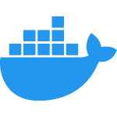

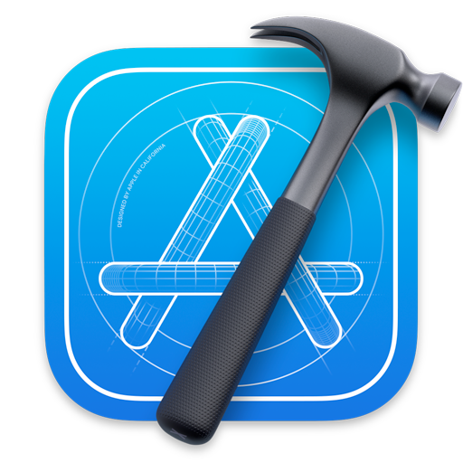



MLOps - Tech Stack
Data
Models
Development
Operations
Spark
FastAPI
GitHub
TensorFlow
PyTorch
MXNet
Hadoop
React
Docker
Kafka
JupyterLab
Google Colab
Deepnote
Vertex AI Models
Angular
Xcode
Bigquery
Airflow
Amazon Sagemaker
Android Studio
Vertex AI Pipelines
VS Code
OpenAI
Gemini
Anthropic
Jet Brains
DVC
Elastic
Weights & Biases
Neo4j
Weaviate
Kubeflow
Neptune.ai
Data Engineers
Data Scientists
Software Engineers
Systems Engineers
Notes:
GitHub: is a hosted version control system and helps teams collaborate development
Docker: is a platform for developing, shipping, and running applications in a containerized fashion. Docker enables you to separate your applications from your infrastructure so you can deliver software quickly.
FastAPI: is a modern, fast (high-performance), web framework for building APIs with Python 3.6+ based on standard Python type hints.
React: front-end JavaScript library for building user interfaces or UI components. It is maintained by Facebook
Angular: front-end JavaScript library for building user interfaces or UI components. It is maintained by Google
XCode: Apple's integrated development environment for macOS, used to develop software for macOS, iOS, iPadOS, watchOS, and tvOS
Android Studio: is the official integrated development environment for Google's Android operating system
VS Code: Visual Studio Code is a code editor built by Microsoft, redefined and optimized for building and debugging modern web and cloud applications
Jet Brains: software vendor specializing in the creation of intelligent development tools, including IntelliJ IDEA, PyCharm, WebStorm

Slide 24







MLOps - Tech Stack
Data
Models
Development
Operations
Spark
FastAPI
GitHub
GCP
AWS
TensorFlow
PyTorch
MXNet
Hadoop
React
Docker
Kubernetes
Kafka
JupyterLab
Google Colab
Deepnote
Angular
Xcode
Jenkins
Ansible
Bigquery
Vertex AI Models
Airflow
Amazon Sagemaker
Android Studio
GitHub Actions
Vertex AI Pipelines
VS Code
Cloud Functions
OpenAI
Gemini
Anthropic
Jet Brains
DVC
TensorFlow Serving
Elastic
Weights & Biases
Amazon Sagemaker
Hosting
Neo4j
Weaviate
Kubeflow
Neptune.ai
Vertex AI Deploy
Data Engineers
Data Scientists
Software Engineers
Systems Engineers
Notes:
Google Cloud Platform (GCP): Is a suite of cloud computing services offered by Google
Amazon Web Services (AWS): offers reliable, scalable, and inexpensive cloud computing services
Kubernetes: is an open-source system for automating deployment, scaling, and management of containerized applications.
Jenkins: is an automation server which enables developers around the world to reliably build, test, and deploy their software
Ansible: is an IT automation platform that makes your applications and systems easier to deploy and maintain. Automate everything from code to infrastructure.
TensorFlow Serving: is a flexible, high-performance serving system for machine learning models, designed for production environments
Amazon Sagemaker Hosting: is a model hosting environment available through Amazon Sagemaker
DataRobot: is an AI platform that can accelerate and democratize data science by automating the end-to-end journey from data to value. Allows to deploy AI applications at scale

Slide 25
MLOps - Tech Stack
AI / ML
Development
Operations
Data:
APIs:
Source Control:
Label Studio
DVC
FastAPI
Model Serving
GitHub
Framework:
Containerization:
TensorFlow
PyTorch
LLM APIs:
Docker
OpenAI
Gemini
Cloud Provider:
ML Tasks:
Google Cloud Platform
Frontend:
Google Colab
Vertex AI
React
Continuous Integration/ Deployment:
GitHub Actions, Ansible
Tracking:
IDE:
Scaling:
W&B
Custom
VS Code
IDE of choice
Kubernetes
Notes:
In this class we will be using the following tech stack and the tutorials and examples will cover these topics

Slide 26
Outline
Why should you take this class? And why not?
Who are we?
Course structure and activities: What can you expect?
Class organization: What are the workload, logistics, and grading system?
Projects

Slide 27
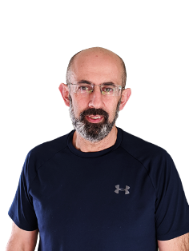
Who? The Astro-AI-Statistician Who Rocks The Kitchen!
Roles:
The Science Wizard: Scientific Director at OMPD (DS and CSE Masters’).
Course Maestro: Instructs CS1090a, CS1090b, and AC215 like a boss.
Astro-Guru: Stoked about the next-gen telescopes that are about to revolutionize our view of the universe!
Research Lab:
StellarDNN Maverick: Tackles cosmic mysteries where astronomy, ML, and stats collide!
His Interests? Cracking open differential equations with deep neural networks, being a detective in deep neural network inference, and teaching NLP techniques to chat with stars (well, in astronomical time series analysis, but let's keep it jazzy!).

Slide 28

Who? The Astro-Statistician Who Rocks The Kitchen!
Fun Facts:
Musical Soul: Classical tunes and opera are his jam. The Boston Symphony Orchestra is his second home!
Culinary Artist: Holds a cooking badge of honor from Le Cordon Bleu and enjoys both whipping up a storm and devouring the results.
Adventure Junkie: From biking up mountains to skiing down them, from kayaking to hooking fish mid-air—this professor is always on the go!

Slide 29
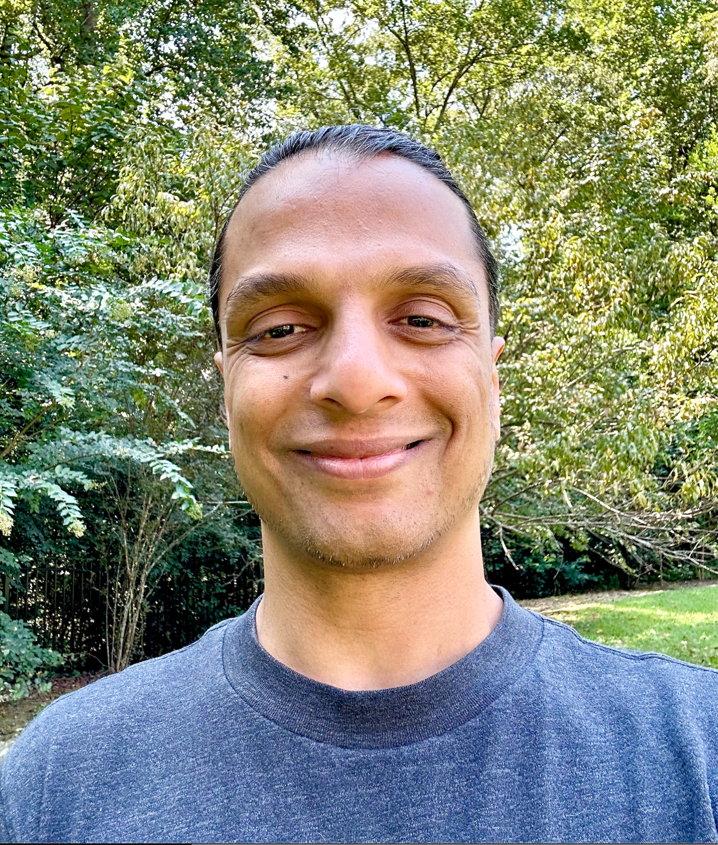
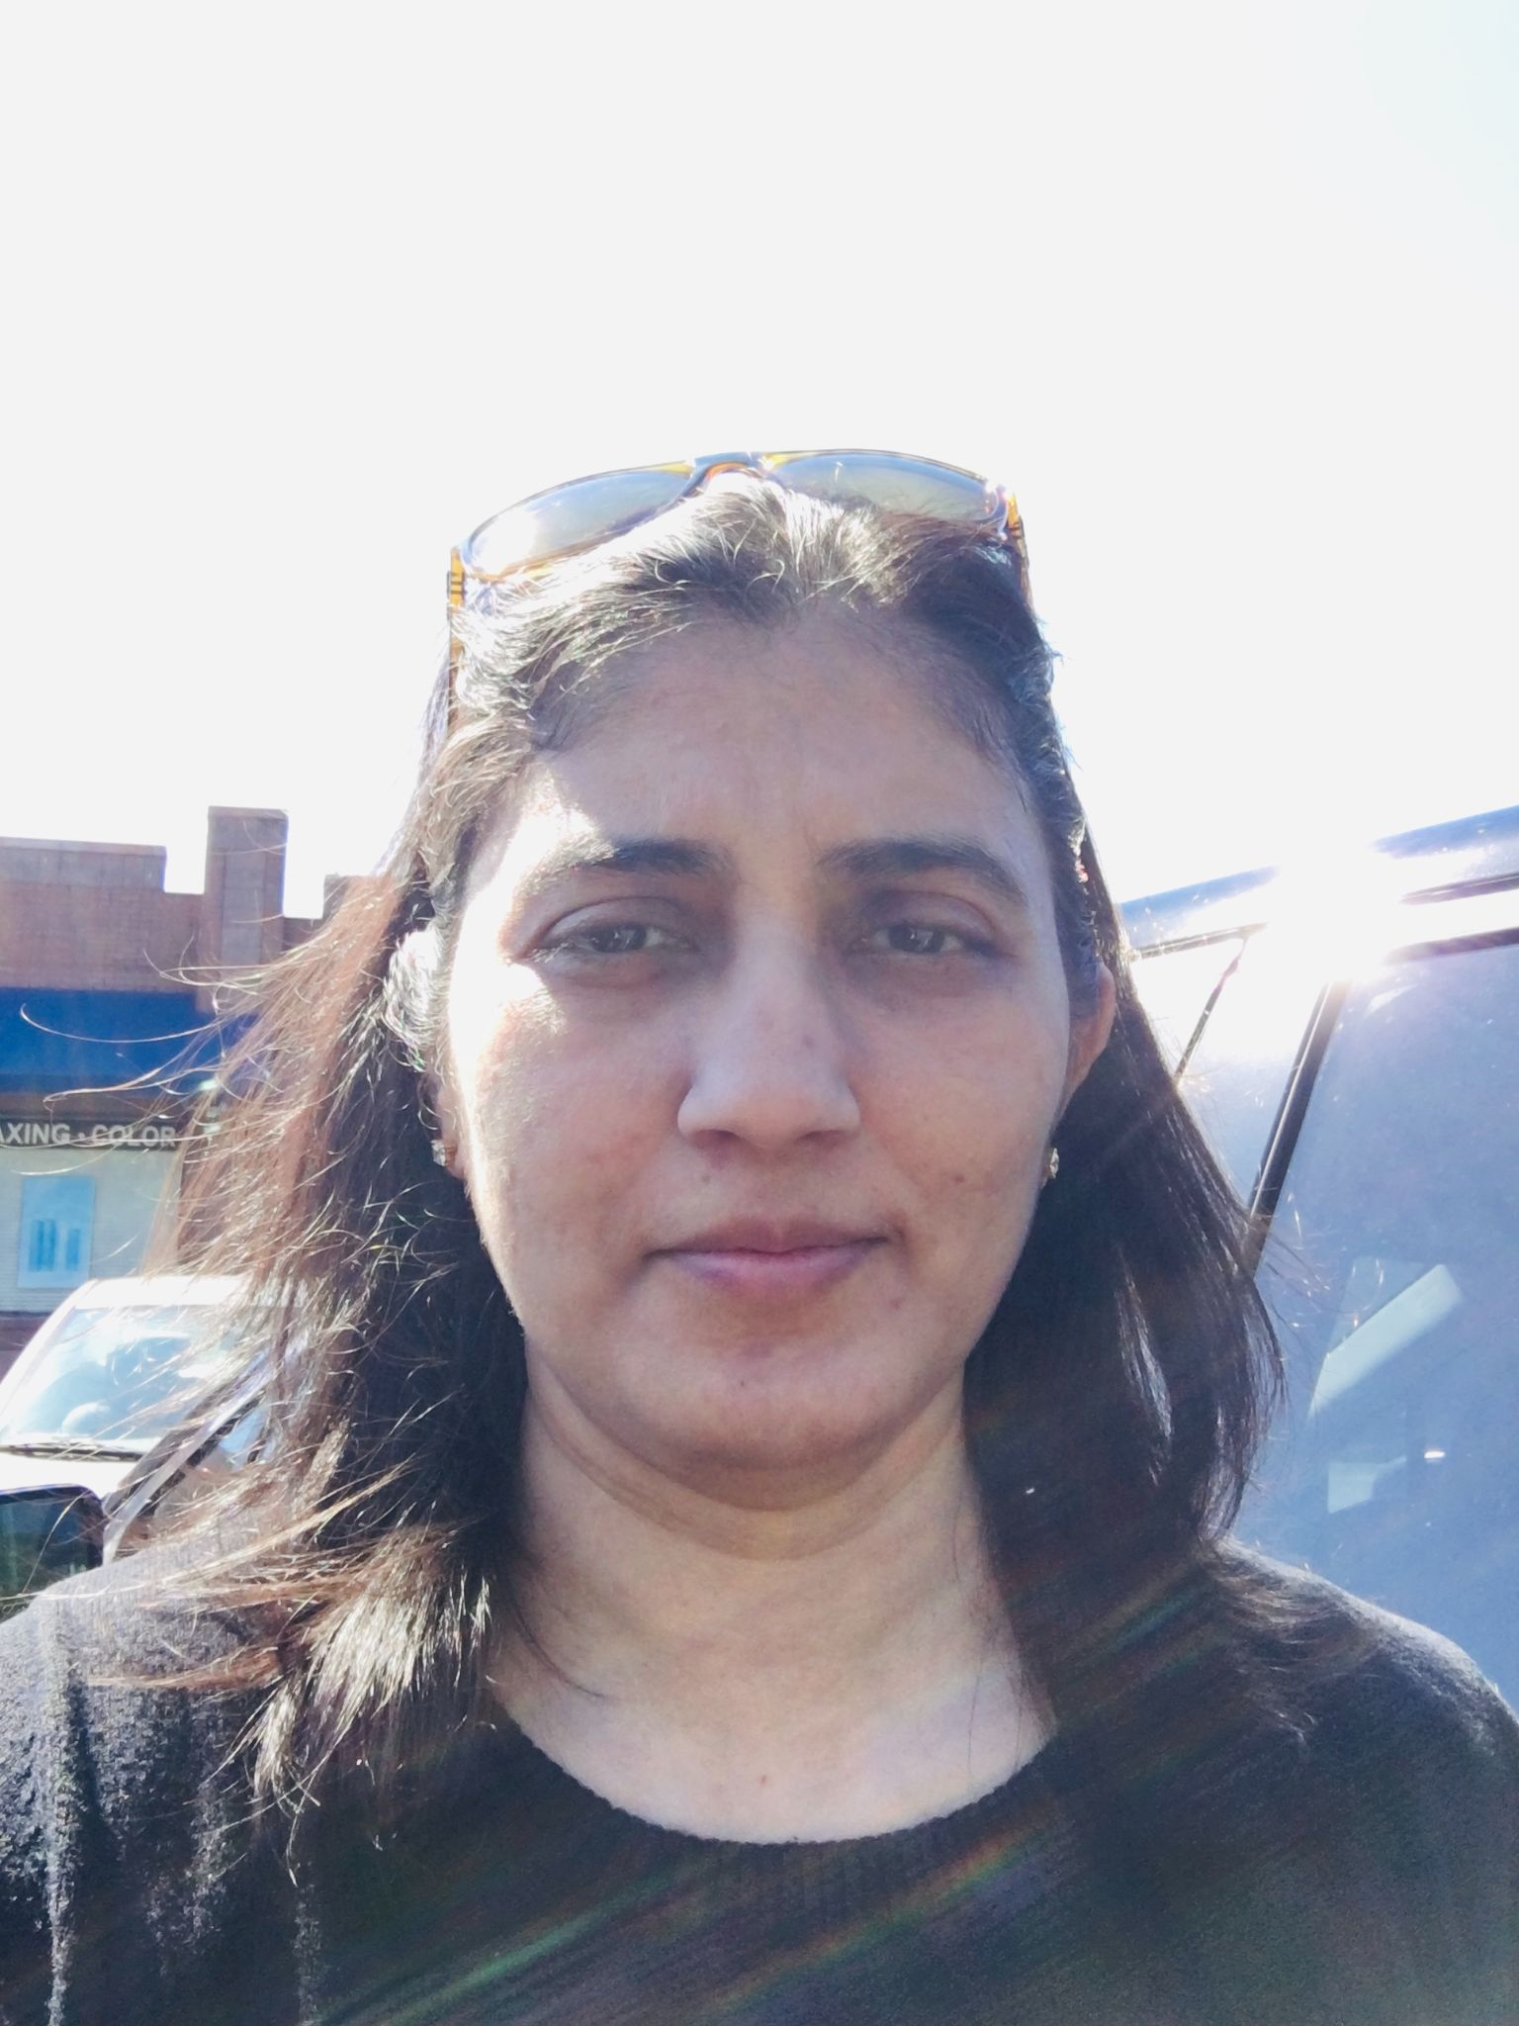


Who?
Shivas Jayaram
Deep Learning Researcher, Educator and Practitioner
Currently working on a medical-pharma startup
Fun Fact: Just started a new hobby - Beekeeping
Rashmi Banthia
TF for many Data Science classes here at Harvard including CS109A/B.
Fun Fact: Enjoys kaggle competitions
Chris Gumb
SEAS preceptor, assisting with courses for the DS and CSE Master’s programs.
Fun Fact: Used to work at a (now defunct) comedy club in Boston.
Ignacio Becker
He has a Ph.D. in Computer Science and trained as an astronomer.
His main area of research is AI applied to astrophysical problems.
Nowadays, he focuses on developing models to leverage the massive real-time data stream.

Slide 30

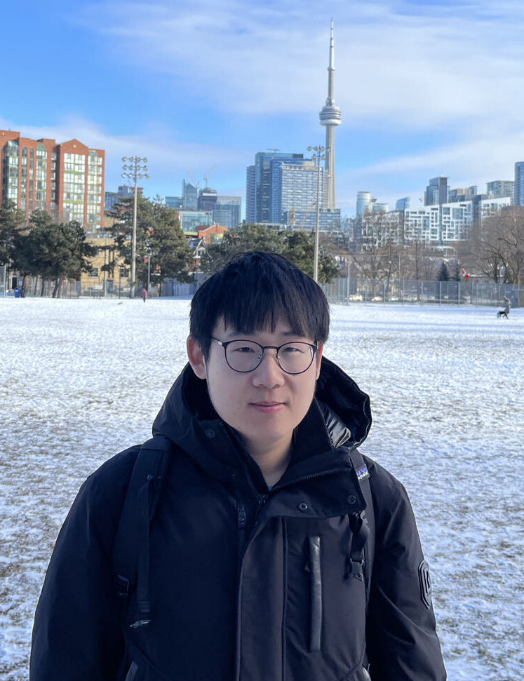
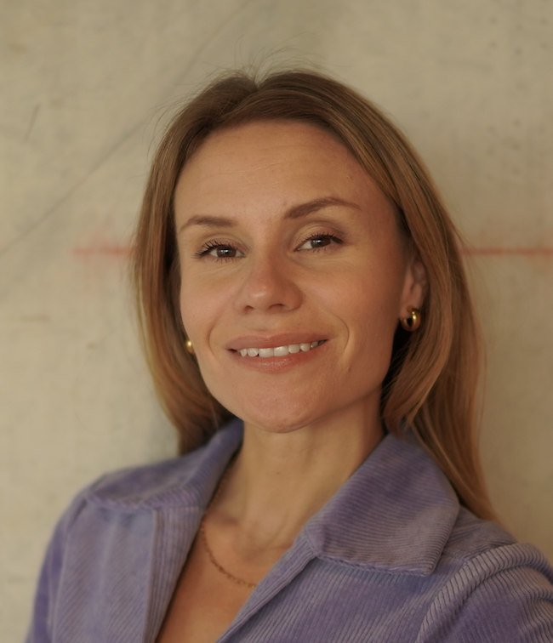
Who?
Luis Ribeiro
Machine Learning Engineer
Fun Fact: I'm considering creating a YouTube channel about AI/DS
Li Yao
TF for many Data Science classes including CS109
Fun Fact: Has a collection of rare stones
Yasmine Morrison
Venture capitalist investing in pre-seed/seed startups.
Fun Fact: Started a podcast called Venture Analytics (launching soon)

Slide 31
Outline
Why should you take this class? And why not?
Who are we?
Course structure and activities: What can you expect?
Class organization: What are the workload, logistics, and grading system?
Projects

Slide 32
Course Structure and Activities
Two lectures/tutorials per week
Projects
Assignments

Slide 33

Lectures
Two lectures per week. There will be a combination of lecture style and hands on tutorials.
Lecture & Tutorials

Slide 34
Lectures
Where do I find the class material?
The official web page for this course is: https://harvard-iacs.github.io/2024-AC215
All lecture PDFs and link to tutorials will be posted here:
https://harvard-iacs.github.io/2024-AC215/schedule/

Slide 35
Topics
Containers
Data Pipelines and Cloud Storage
Data Parallelization
Data Versioning
Advanced Training Workflows
Advanced Inference Workflows
Pipeline Design
App Design, Setup, and Code
APIs & Frontend
Scaling with Kubernetes (k8s)
Additionally, we offer several tutorials on the latest LLM tools, including fine-tuning, agents, and Retrieval-Augmented Generation (RAGs).

Slide 36
Team Projects: Crafting Your Own AI Solutions
Objective: Hands-on project development in AI & MLOps; transform your idea into a functional app.
Guidance: Weekly demonstrations from Pavlos' project provide practical insights and a reference point.
Milestones: Assess project evolution and grasp of MLOps concepts; crucial for grading.
Creativity: Open platform for start-up ideas, research, or personal hobbies.
Assessment: Milestones are key to grades and holistic development.
Group Formation: Starts today, aiming for teams of 3-4.

Slide 37
Projects Milestones
Milestone | Description | Due Date | Points
MS1 | Project Proposals & Team Formation | 09/19 | 4
MS2 | MLOps & Advanced Training | 10/18 | 10
MS3 | Midterm | 10/31 | 25
MS4 | Deployment | 11/15 | 14
MS5 | Final Presentation and Deliverables | 12/11 | 35
For the most up-to-date and accurate information, please visit: https://harvard-iacs.github.io/2024-AC215/

Slide 38
Assignments/Homework
 | Description | Due Date | Points
HW1 | Containers / Setup quota etc |  | 4
HW2 | Create a simple api and consume it |  | 4
HW3 | Use GCP to create a VM and deploy a container |  | 4
For the most up-to-date and accurate information, please visit: https://harvard-iacs.github.io/2024-AC215/

Slide 39
Outline
Why should you take this class and why not?
Who are we?
Course structure and activities?
Class organization (Workload, Logistics, Grades).
Projects

Slide 40

Workload
1 hour Reading
2.5 hours Lectures
1 hour Office Hour/meet with your TF
7.5 hours Project Milestones
~ 12 hours/ week

Slide 41

Expectations: Attendance
Attending class isn’t just required; it’s something I look at closely when deciding on academic and professional recommendations.
Please understand that consistent presence and engagement in the classroom are highly valued in this course.

Slide 42

Expectations: Attendance
All lectures are videotaped, so you can watch them later if you can’t attend.
BUT
You will earn 1 extra late day for every 5 lectures you attend!

Slide 43
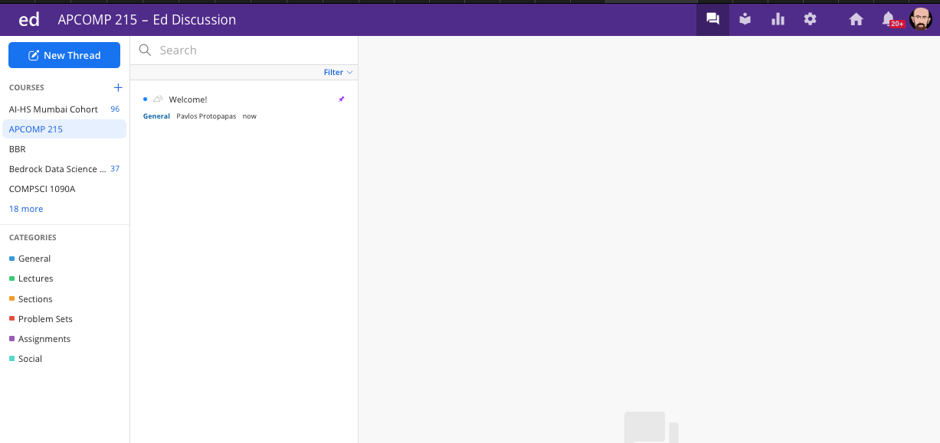
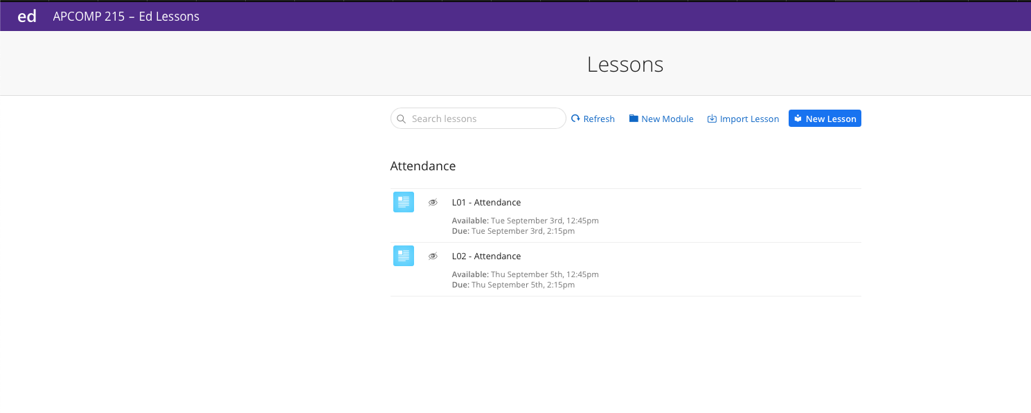
Expectations: Attendance
How to record attendance:
Step 1: go to edstem
Step 2: Copy the secret word from the board

Slide 44
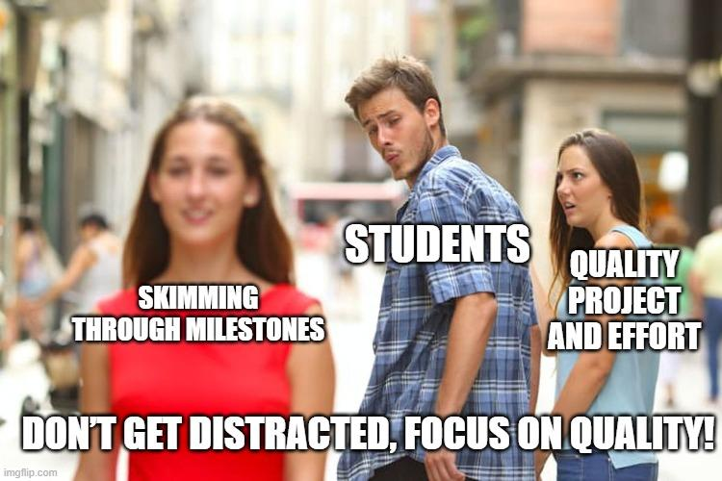
Expectations: Projects
This course is project-based, and your grade will depend on the quality of your project. We will place significant emphasis on both the effort you put into the project and the quality of your completion of its milestones.
Project-based courses may offer opportunities for higher grades, but it is ultimately up to you to learn and apply the feedback provided to improve your work for future milestones.

Slide 45
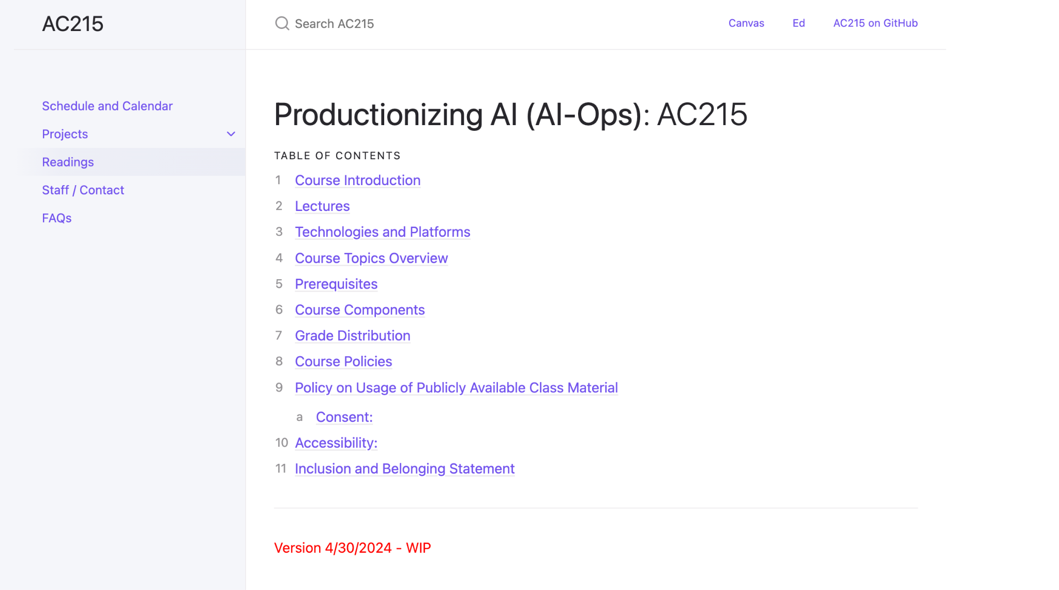
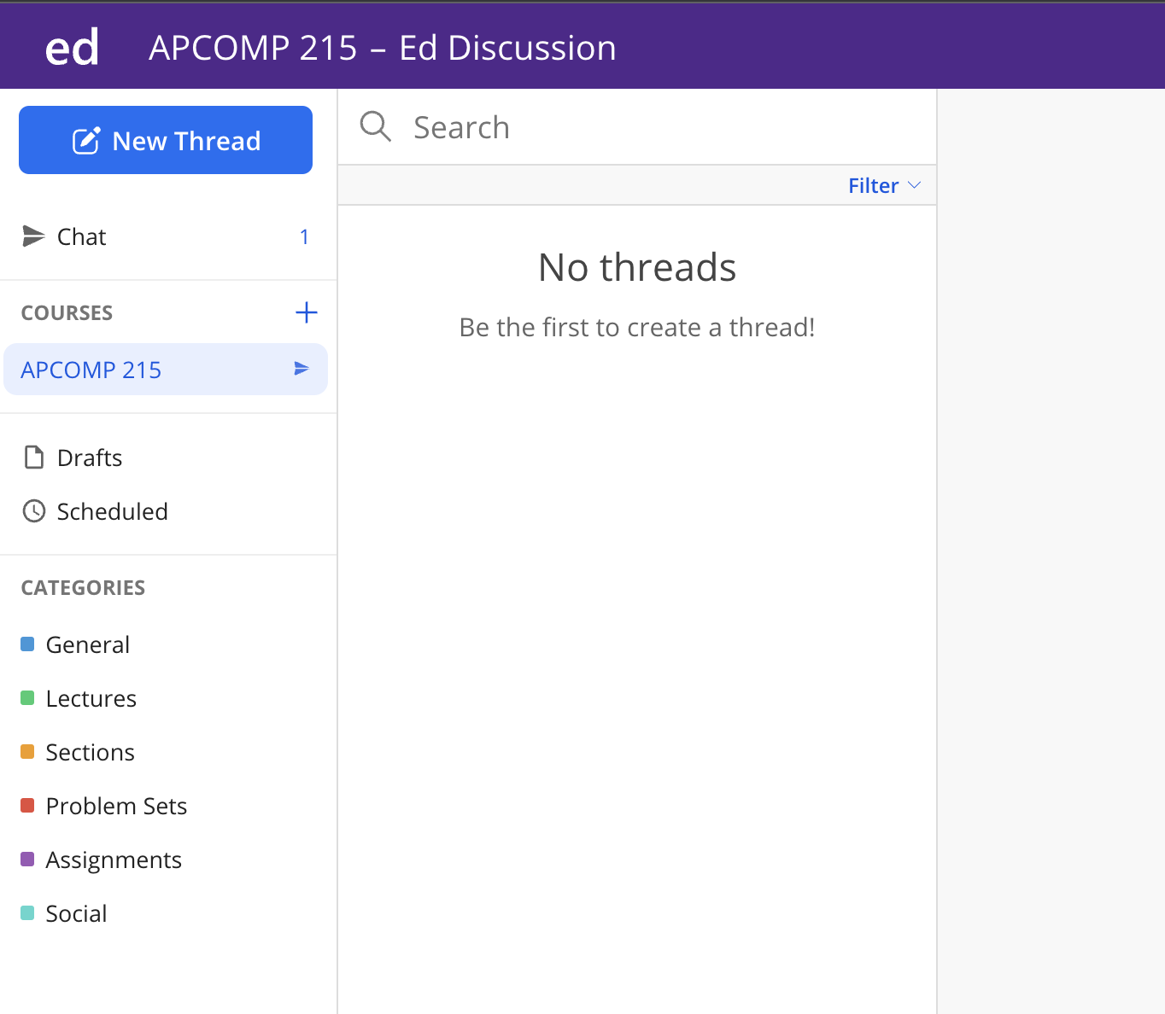
Course Components
Course web page
ED Stem
https://harvard-iacs.github.io/2024-AC215/
https://edstem.org/us/courses/42775/discussion/
Notes:
https://harvard-iacs.github.io/2024-AC215/
https://edstem.org/us/courses/42775/discussion/

Slide 46
Grades
Assignment | Final Grade Weight
Milestone 1 | 4%
Milestone 2 | 10%
Milestone 3 | 25%
Milestone 4 | 14%
Milestone 5 | 35%
Homework 1 | 4%
Homework 2 | 4%
Homework 3 | 4%
Total | 100%
For the most up-to-date and accurate information, please visit: https://harvard-iacs.github.io/2024-AC215/

Slide 47
Final Details
We will be using ED for discussions, announcements and surveys
Canvas for some of the submissions and group formations
Submissions for project milestones and projects will be using GitHub – details will follow soon

Slide 48
Outline
Why should you take this class and why not?
Who are we?
Course structure and activities?
Class organization (Workload, Logistics, Grades).
Projects

Slide 49
Projects
In Class Demo: Formaggio.me, an AI cheese sommelier.

Slide 50
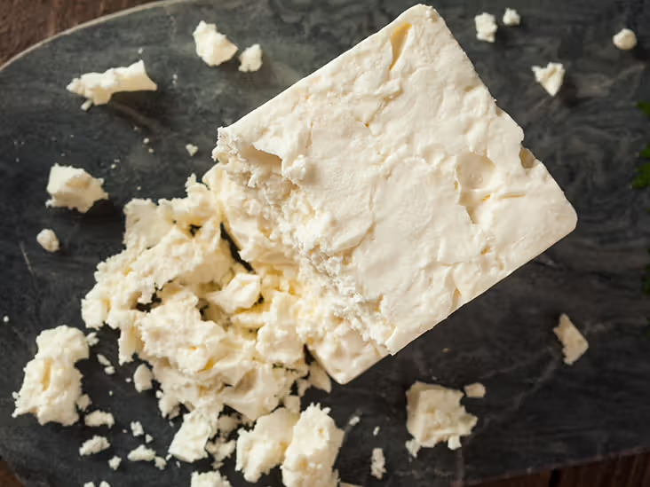
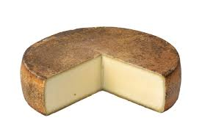
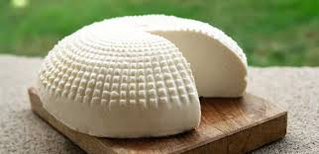
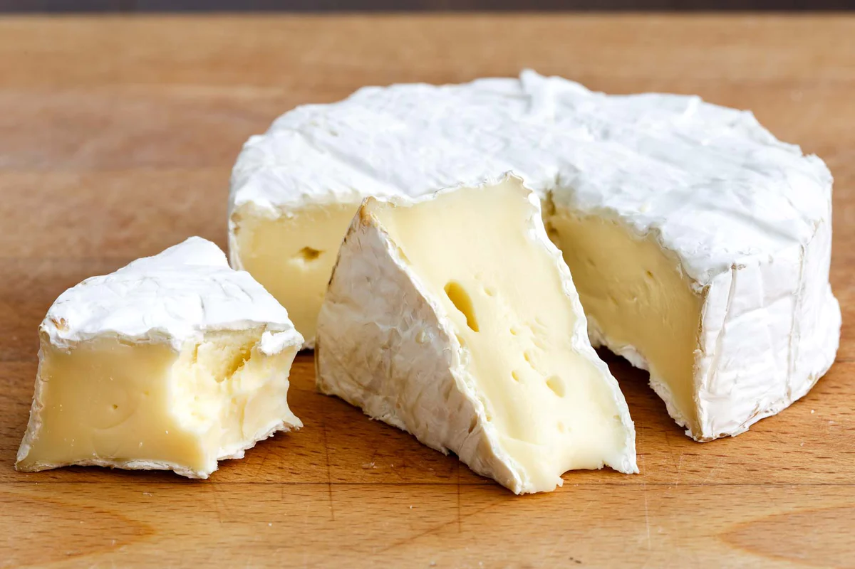
Project Idea
Pavlos likes cheeses and when he throws parties he always have cheese for his guests.
He wants to build an app to identify cheese types and learn what cheeses go with each other, how to pair it with wines, the way this particular cheese is made, a history of the cheese etc.
Project Summary
Notes:
https://docs.google.com/document/d/10nnbbFIi2JuE95kCLhAZ5fSxbG3X93_6YEOjPR8wyeY/edit?usp=sharing

Slide 51
Formaggio.me Problem Definition
Imagine being able to identify a cheese by simply taking a photo of it. Our app uses AI-powered visual recognition technology to help you identify the cheese you're looking at, and then provides you with a wealth of information about it.
Take a photo of the cheese, and our app will identify it for you. Then, dive deeper into the world of cheese with our interactive chatbot. Ask questions about the cheese's origin, production process, nutritional information, and history.

Slide 52
Formaggio.me Problem Definition
Want to host a cheese-tasting party? Formaggio.me makes it easy. Use our app to select the perfect cheeses for your gathering, and then get expert advice on pairing them with wines, crackers, and other accompaniments. Our chatbot is always available to help you plan the perfect cheese platter.
Formaggio.me is your one-stop-shop for all things cheese. With our app, you'll never be stuck wondering what that delicious cheese is or how to pair it with other foods. Whether you're a cheese aficionado or just starting to explore the world of cheese, Formaggio.me is the perfect companion for your culinary journey.

Slide 53
Proposed Solution
Key Features:
Visual cheese identification using AI-powered technology
Interactive chatbot for asking questions about cheese
In-depth information on cheese origin, production process, nutritional information, and history
Expert advice on pairing cheese with wines, crackers, and other accompaniments
Perfect for cheese enthusiasts, party planners, and anyone looking to explore the world of cheese

Slide 54
Project Execution Steps
Project Ideation / Requirements
Data Exploration
Model Exploration
Prototyping
Model Serving
Product Development
ML Integration
Deployment

Slide 55
Resources
We will be using Google Cloud Platform (GCP). Each student receives a credit allocation, and we have extensive experience working with GCP. All tutorials will be conducted in GCP environments using TensorFlow and PyTorch.
While AWS tutorials will be provided, they are not fully supported or extensively tested.
Additionally, we expect to have GPU credits from Modal, along with a guest lecture.

Slide 56
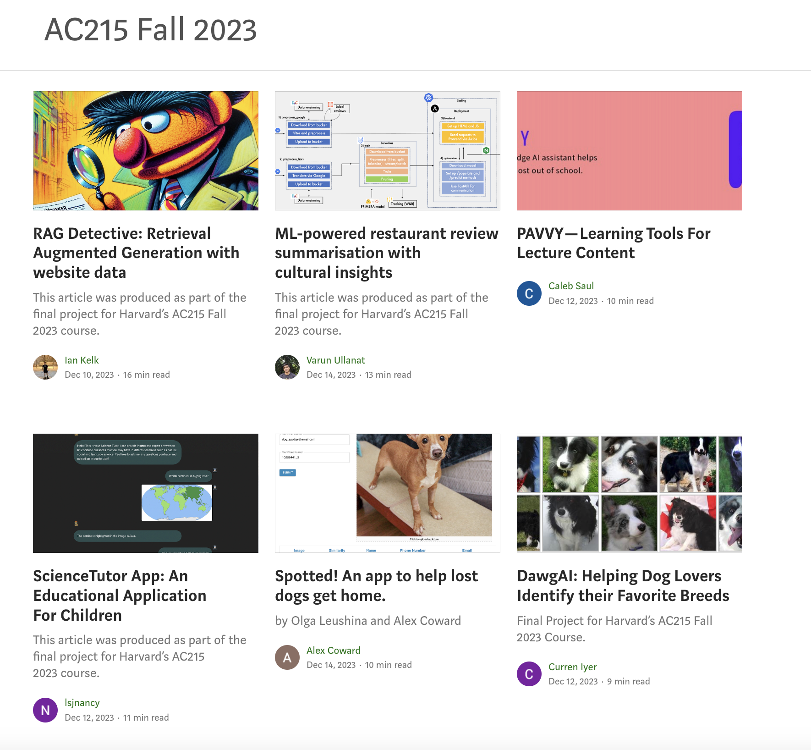
Previous Year’s Projects
https://medium.com/institute-for-applied-computational-science/ac215-fall2023-projects/home
Notes:
https://medium.com/institute-for-applied-computational-science/ac215-fall2023-projects/home

Slide 57
How to Scope your Project
Proof Of Concept (POC)
Prototype
Pilot
Minimum Viable Product (MVP)
Experiment potential ideas
Check feasibility of the idea
Use a subset of data to make experiments simpler to run
E.g.: Verify if our language task can be performed by transfer learning using a transformer model
Users: Internal team
Duration: Days to few weeks
A mockup or functional product that can showcase your ideas
E.g.: A mockup web app to show user experience and flow
Users: Internal team
Duration: Weeks
A usable and functional product of your solution
Used to test out the product with real users and performing real use cases
E.g,: An api endpoint of a model for prediction, a simple one page app to showcase a model’s prediction capability
Users: Internal / External
Duration: Weeks
Expanding on the Pilot to build something that real users can use
E.g.: Production deployed app that can predict the cheese and respond to prompts
Users: External
Duration: Months

Slide 58
Project Scope (Cheese App)
Proof Of Concept (POC)
Prototype
Minimum Viable Product (MVP)
Scrap cheese images and documents (books etc)
Verify images and pdfs
Experiment on some baseline models
Verify new unseen cheeses are predicted by the model(s)
Verify ideas using any instruct-LLMs
Create a mockup of screens to see how the app could look like
Deploy one model to Fast API to service model predictions as an API
Create App to identify Cheeses and respond appropriately to a series of prompts
API Server for uploading images and predicting using best model
API Server for serving the language models

Slide 59
Office Hours (For this week only)
Li Yao - Tuesday 3:30 - 4:30 PM
Rashmi B - Friday 9:30-10:30 AM - Online (Canvas -> Zoom)
Notes:
PP: Add a slide to point to the tutorials

Slide 60
Logistics
Survey
Make project groups
Setup & Installations
Notes:
https://docs.google.com/spreadsheets/d/1B8JePYtWLP-2dqOEwneW-gmasHBlxn03/edit?usp=drive_link&ouid=109490521694988502723&rtpof=true&sd=true
https://docs.google.com/document/d/1ixys_vzy5msA1oqRc3-YDKxt-nhSSSv3at1z0qQk8-I/edit?usp=sharing

Slide 61
THANK YOU
Notes:
PP: Add a slide to point to the tutorials

